Slide 1
Automatic Ticket Assignment AIML’ 19-20 Capstone Project - GRP 10 C
Supervised & Mentored By
Survesh Chauhan
PM
Remya Nair
Presented By
Ram Gopal
Krithika
Mithun
Mexi Dsouza
Karthickeyan

Slide 2
Contents
Executive Summary
EDA, Data Cleansing & Text Pre-Processing
Model Building
Hyper-Parameter Tuning
Metrics Evaluation
Models Comparison
Challenges Faced & Resolution Taken
Conclusion
Further Steps

Slide 3
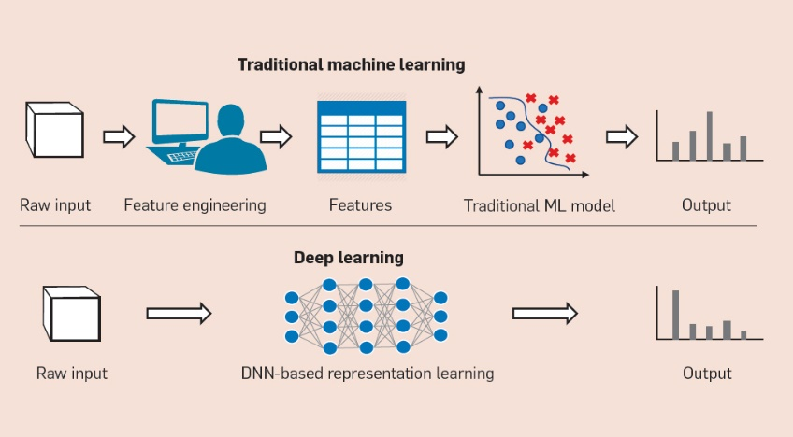
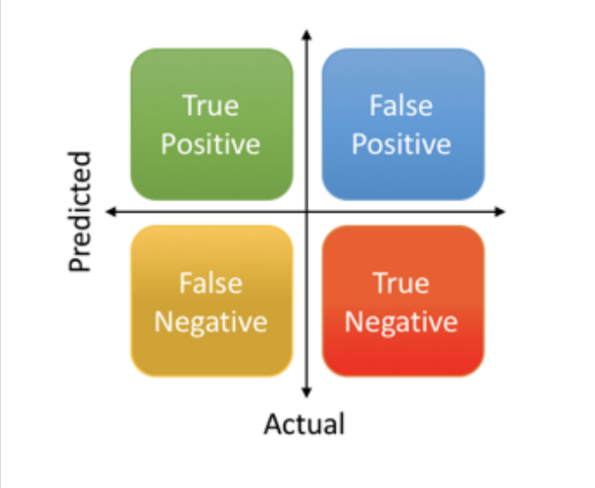
Executive Summary
Data - 8500 rows and 4 columns
Description
Short Description
Caller
Assignment Group
Work Split into 4 MILESTONES:
MILESTONE 1: EDA, Data Cleansing & Pre-Processing
MILESTONE 2: Model Building
MILESTONE 3: Test the Model, Fine-tuning
MILESTONE 4: Bidirectional LSTM, Hyper-Parameter tuning, & State Of The Art Modeling
Model Building:
Traditional Machine Learning models – 5
Deep Learning models with Hyper parameter tuning – 5
State of the Art Models - 2
Metrics Used:
F1 Score
Accuracy
Classification Report
Confusion Matrix
Top 3 performing Models:
ULMFit
GRU
Bidirectional LSTM

Slide 4
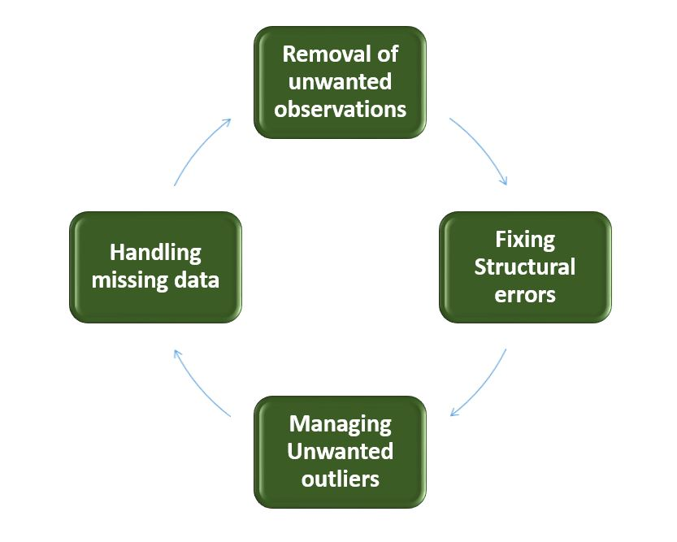
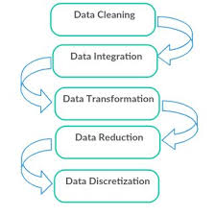
EDA, Data Cleansing & Text Pre-Processing
Target Variable : Assignment Group
Dependent Variable: Description + Short Description
Data Cleaning includes:
NULL values
Duplicate cells
Non-ASCII
Special characters
Random combination of alphabets which are not readable
Foreign languages(Mostly German)
Static words like Email Disclaimers
Email Attributes
Text Pre-processing includes:
Removal of Duplicate words
Non-English and Non-ASCII characters
Text translation
Removal of Disclaimer messages
Generic Email-Attributes
Notes:
As part of Pre-Processing, we defined a number of functions to handle different problems:
Removal of Duplicate values within a cell,
To handle the Non-English and Non-ASCII characters
To translate the data into English, we incorporate the Google Translated API Translate_to_English().
To handle Disclaimer messages we created Remove_Disclaimer()
To remove the genericEmail-Attributes we created Clean_Data()
Certain text might sound as junk but cannot be simply cleansed, but needs improved handling since they are the essential part of the IT ticket raised for that we created preprocess_replace()
Created a Word Vocabulary from the corpus of report text data.

Slide 5
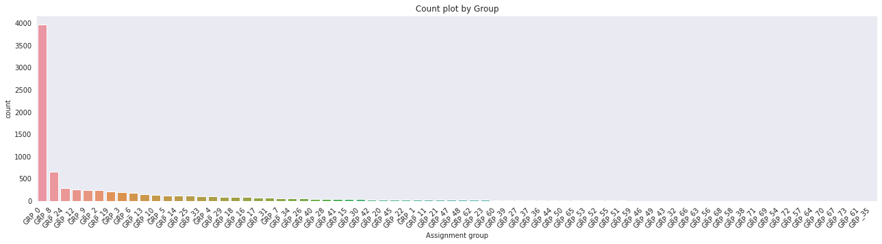
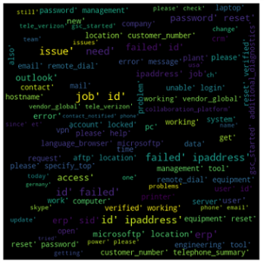
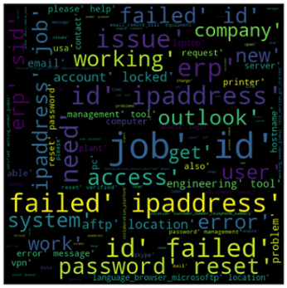
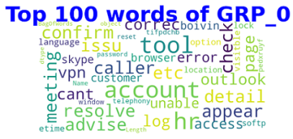
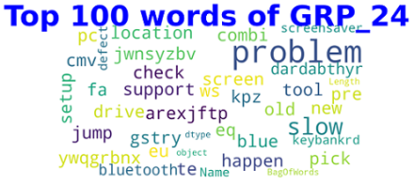
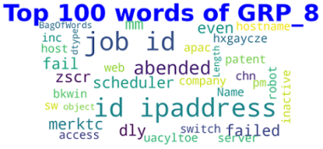
EDA, Data Cleansing & Text Pre-Processing
Skewed Data
Word Clouds for Bigrams, Trigrams and Top 3 Groups

Slide 6
Model Building
Machine Learning
Logistic Regression
Support Vector classifier
Deep Learning
Sequential NLP
LSTM
State of the ART
ULMFit
BERT
Decision Tree Classifier
Random Forest Classifier
AdaBoost Classifier
Word2Vec
GLOVE
Bidrectional LSTM
RNN
GRU
GLOVE
HyperParameter Tuning

Slide 7
Hyper-Parameter Tuning
Hyperparameters:
1. Maxlen
2. Embedding Size
3. Learning Rates
4. Batch Size
5. Epoch, etc
Embedding Weight matrix:
1. Word2Vec
2. GLOVE
Activation Functions:
1. Tanh
2. Relu
3. Softmax
Loss function:
1. Sparse categorical Entropy
Default values used:
Maxlen = 100
Embedding size = 100
Batch size = 100
Learning rate = 0.01
Embedding = Glove
Activation Function = Tanh, Softmax
Epochs = 5

Slide 8
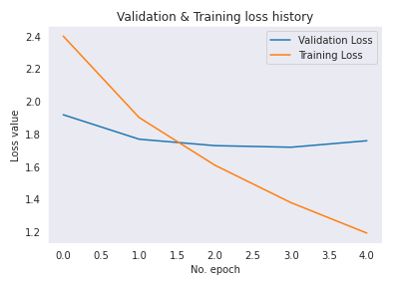
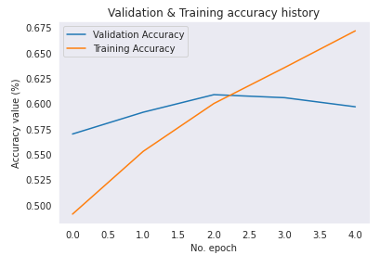
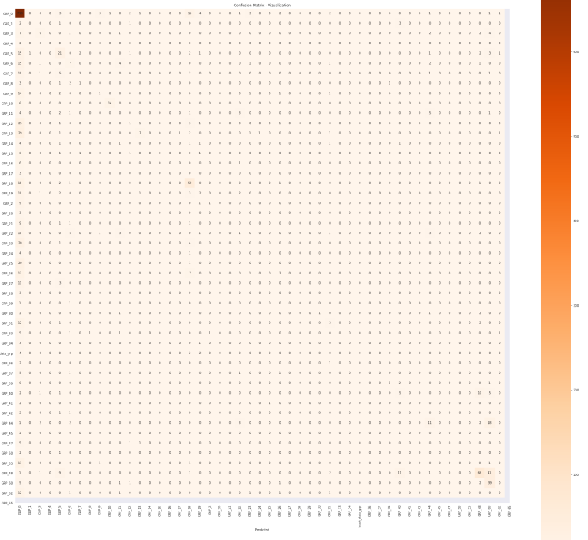
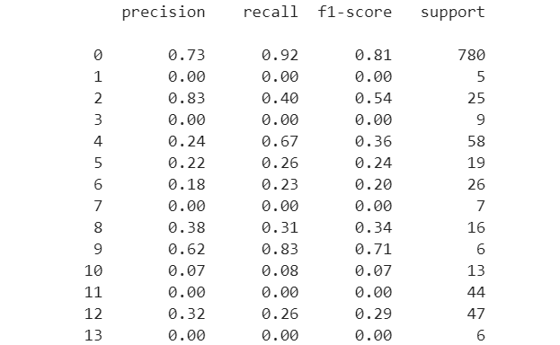

Metrics Evaluation
Metrics used:
Accuracy Score
F1 Score
Classification Report
Precision
Recall
Visual Aids:
Loss Graph
Accuracy graph
Confusion matrix

Slide 9
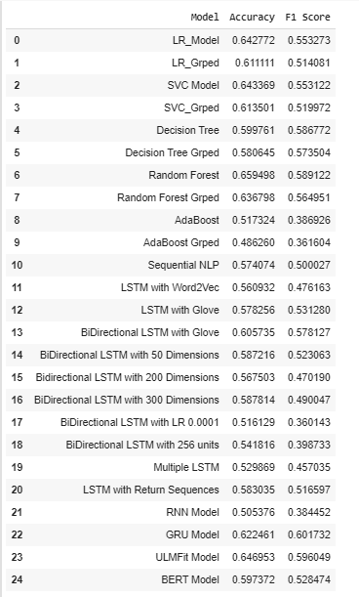
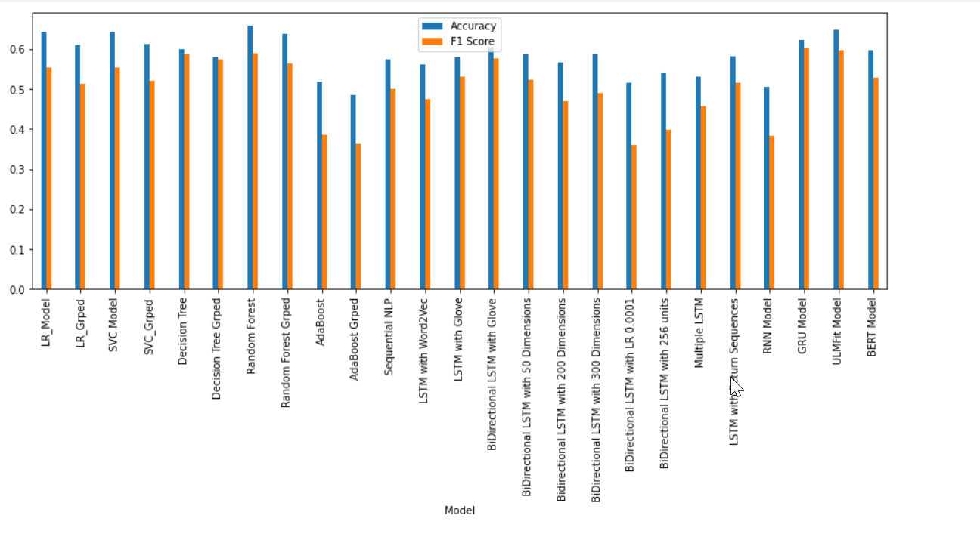
Models Comparison
Score Evaluation across Models:
Top 3 performing Models:
ULMFit
GRU
Bidirectional LSTM

Slide 10

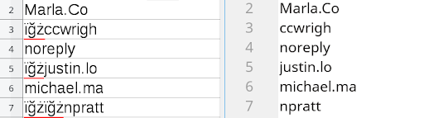


Challenges Faced & Resolution taken
Handling of Skewed Data
Handling of Junk Values
Handling of other languages
Tensorflow compatibility for BERT model

Slide 11
Conclusion
The data cleansing and pre-processing was done, also Bi-Gram, Tri-Gram and Word Cloud were built to understand the mapping between language and Ticket groups.
ML Models with TFIDF vectorization were built and executed, Along with Deep Learning algorithms.
Random Forest and Decision Tree Models performed well among Machine learning models.
Hyper parameter tuning was also done for different parameters such as maxlen, embedding size, epochs, batch size, learning rate, etc
GRU is the best model in Deep Learning algorithms followed by Bidirectional LSTM with Glove.
State Of The Art Models such as ULMFit and BERT were also built and executed.
The accuracy and F1 score of all the models are less than 65%. This is because the given data is highly skewed with GRP_0 data. Accuracy, F1 Score < 65%
Reflections:
Tailor made functions for data cleaning and preprocessing.
2 different approaches to handle the groups that had least data.

Slide 12
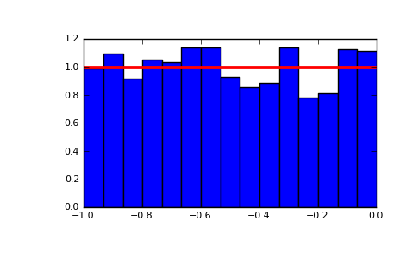

Further Steps
Data Sampling:
Collect more data about other assignment groups.
Perform data sampling to remove skewness
2. Two Model Approach for Grp 0 and rest of the groups:
A binary classifier to identify whether the ticket belongs to GRP_0 or not.
Another multi-class classifier to run the model to classify rest of the assignment groups.
3. ML Pipeline to automate the Model Buiding:
Develop a ML using apache airflow to automate the model building process

Slide 13
Thank you!

